Slide 1

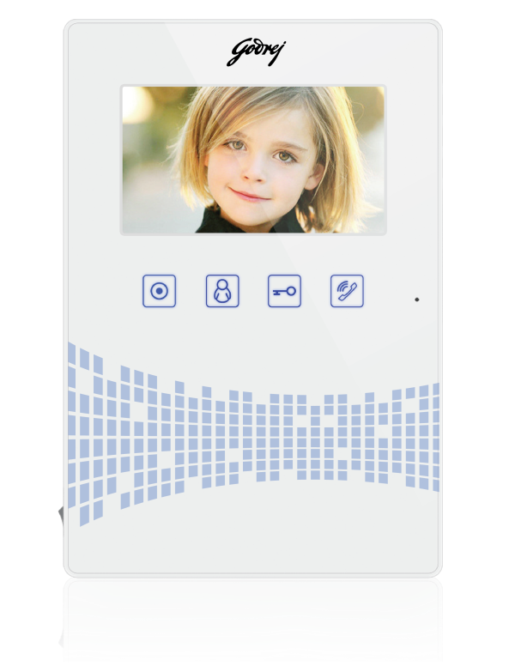
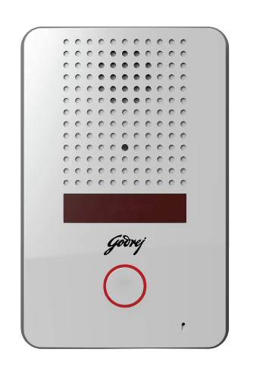

SEETHRU 4.3 Color Hands-free VDP

Slide 2



“I need multiple indoor units”
Supports 3 indoor units.
“I need retrievable images and videos”
Supports removable SD card .
Consumer profile
HH income 5 Lacs & above
Style conscious,
Working Professionals, Nuclear Families
Tech Savvy, Mobile
Builders
“I don’t know who had come to visit me when I’m away.”
In built Memory to store video.
Certified

Slide 3
Feature | Benefit to the Customer
4.3” Indoor Screen option | Clear and Crisp images to help better identification and recognition of the visitor
Supports Upto 2 Outdoor Unit | Dual Tier Security Level – One at Gate entry, second at main door entry. Suitable for multi-entrance villa.
Supports 3 Indoor Monitors | Answer visitor call form anywhere in the house. Extend monitoring capability to Study Room, Kitchen, Bedroom etc
Supports SD to capture photographs and record videos | View, Copy, e-mail, manage visitor photographs and video clip using SD card

Slide 4
SEETHRU 4.3” Color Hands-free VDP

